Slide 1
Plagiarism detector
D.Anuradha
21671A0583
IV Btech

Slide 2
Abstract
Plagiarism detector detects the plagiarism from the files ,calculates the percentage and displays it.
In this project we used sequence matcher module from difflib and used kivy to develop
GUI.
Sequence Matcher is used to identify content matching from files to calculate percentage of plagiarism from files.

Slide 3
INTRODUCTION
Plagiarism is a act of using someone else ‘s work without proper attribution plagiarism analyzer ensures the originality and integrity of written content .It is included in various domains such as education, publishing, and reseach .The analyzer compares the input text with existing databases or reference materials . Identifies the similarities and highlights .Plagiarism analyzer is bulit using industry-standard tools and frame works such as HTML, CSS,Javascript for algorithm implementation .Our system employs a database to store reference materials and preprocessed data, ensuring efficient comparision and analysis. The analyzer prioritized data privacy security and responsibility for misuse or false accusations of plagiarism

Slide 4
Existing System
A Synopsis of the Current Code Plagiarism Detection System Several significant flaws in the existing code plagiarism detection technique impair its effectiveness.
Error in the Obfuscated Code:
The system finds it difficult to correctly discover code similarities, particularly when the code is purposefully changed or obfuscated to avoid detection. Plagiarism that goes unnoticed may arise from this.
The system doesn't employ sophisticated methods to spot minute alterations in code or odd activity patterns. This implies that complex instances of plagiarism where the code has been
marginally altered or rearranged may go unnoticed.

Slide 5
Proposed system:
An Overview of the Suggested Code Plagiarism Detection System The suggested approach uses cutting-edge deep learning models to greatly increase the efficacy and accuracy of code plagiarism detection.
Code Representation: To represent and analyze code structures, CNNs will be employed. These networks are good at finding intricate connections and patterns in the code.
Similarity Detection: The system uses CNNs to identify complex types of plagiarism, such as those in which the code has been changed or obscured.

Slide 6
Technology Used
The Framework was developed using kivy
We used python and kivy to develop GUI.

Slide 7
Future Scope
1.we would like to compare 2 different sectors that
could benefit from a similar plagiarism check product- art, music and videos. All of these industries currently have a number of outstanding legal cases and disputes over plagiarized content. The the right technology ,plagiarism in all these fields could be minimized through detection and checking prior to distribution.
2.In the light of present situation of Covid we can also use this technology to check whether the projects, assignments or any work assigned to the employee is a genuine work or plagiarized one.

Slide 8
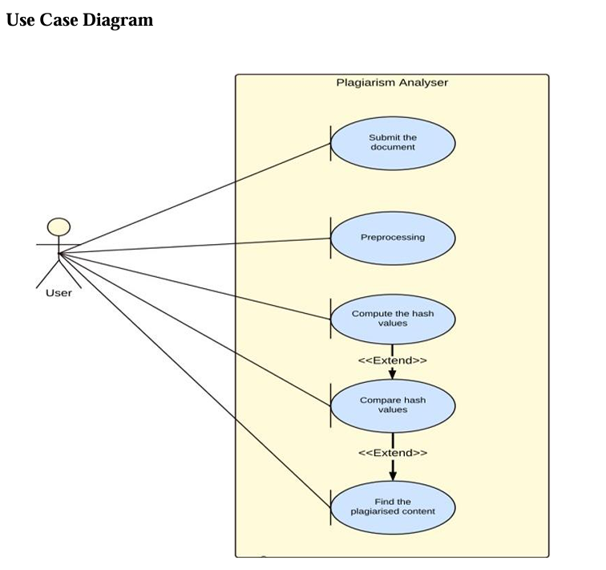

Slide 9
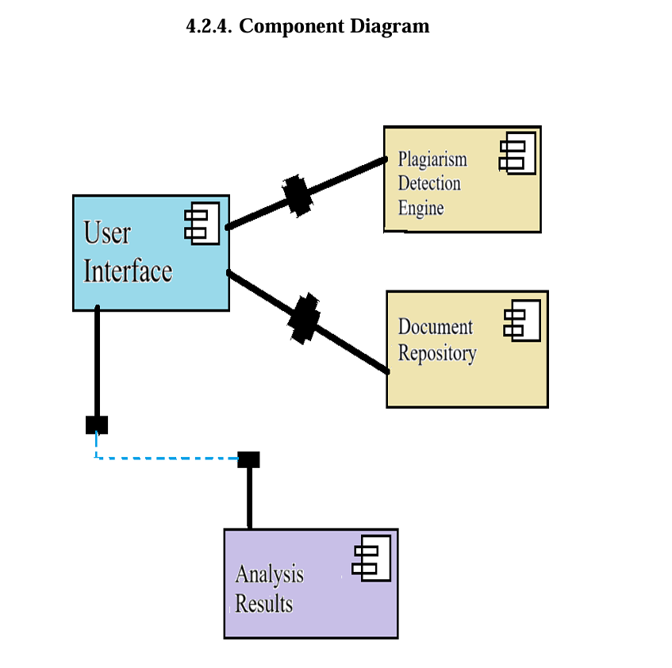

Slide 10
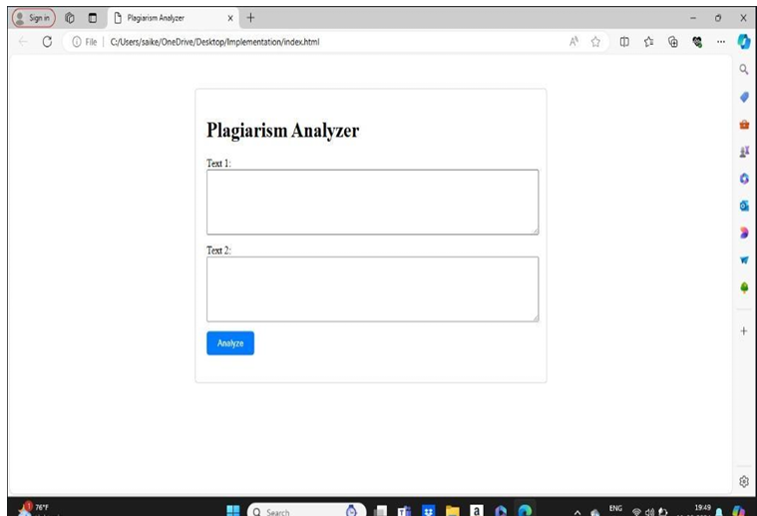
Experimental Results

Slide 11
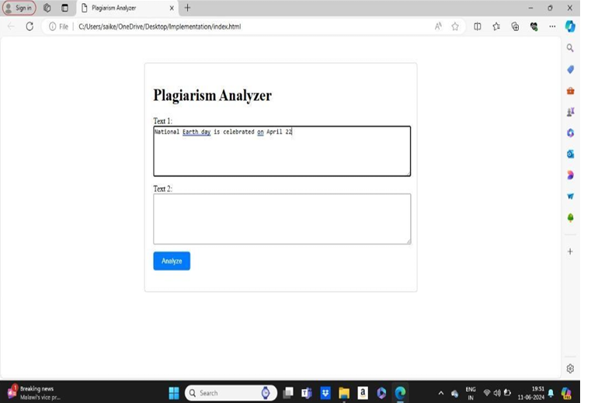

Slide 12


Slide 13
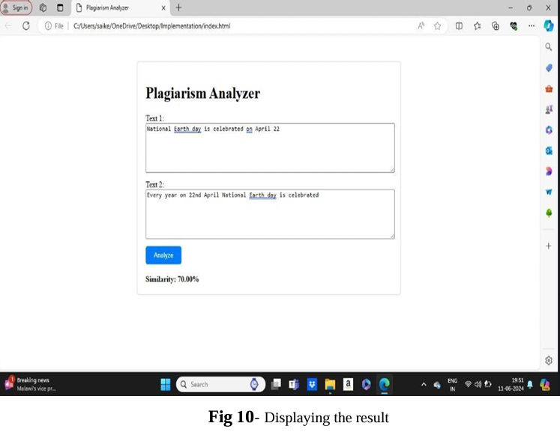

Slide 14
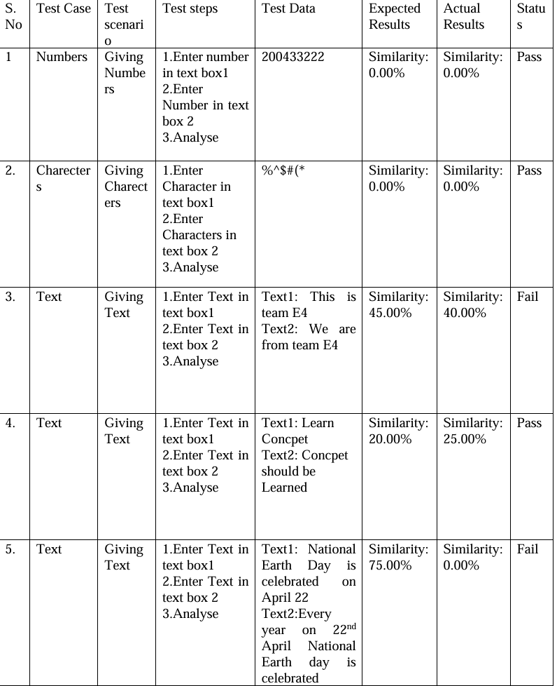

Slide 15

Conclusion
Using someone else’s text without attribution is plagiarism, whether you mean it or not. Unintentional plagiariam of even a sentence or two can have serious consequences.So avoiding Plagiarism is important. It shows the respect of their work.

Slide 16
DRAG AND DROP

